Slide 1

SECA4002 – DEEP LEARNING NEURAL NETWORKS
Dr. V. Vedanarayanan B.E., M.E., PhD
Course Co-ordinator
Assistant Professor, Department of ECE,
School of Electrical and Electronics
SATHYABAMA INSTITUTE OF SCIENCE AND TECHNOLOGY

Slide 2

Course Outcomes
SECA4002 – DEEP LEARNING NEURAL NETWORKS
At The end of this Course, Student will be able to
CO1 | Select suitable model parameters for different machine learning techniques
CO2 | Evaluate the performance of existing deep learning models for various applications
CO3 | Realign high dimensional data using reduction techniques
CO4 | Analyze the performance of various optimization and generalization techniques in deep learning
CO5 | Modify the existing architectures for domain specific applications
CO6 | Develop a real time application using deep learning neural networks

Slide 3
Course Objectives
SECA4002 – DEEP LEARNING NEURAL NETWORKS
Course Objectives:
To present the mathematical, statistical and computational challenges of building neural networks
To study the concepts of deep learning
To introduce dimensionality reduction techniques
To enable the students to know deep learning techniques to support real-time applications
To examine the case studies of deep learning techniques

Slide 4
SECA4002 – DEEP LEARNING NEURAL NETWORKS
Detailed Syllabus:
UNIT 3: DIMENTIONALITY REDUCTION
Linear (PCA, LDA) and manifolds, metric learning - Auto encoders and dimensionality reduction in networks - Introduction to Convnet - Architectures – AlexNet, VGG, Inception, ResNet - Training a Convnet: weights initialization, batch normalization, hyperparameter optimization.

Slide 5
SECA4002 – DEEP LEARNING NEURAL NETWORKS
Recommended Text Books/ Reference Books
Cosma Rohilla Shalizi, Advanced Data Analysis from an Elementary Point of View, 2015.
Deng & Yu, Deep Learning: Methods and Applications, Now Publishers, 2013.
Ian Goodfellow, Yoshua Bengio, Aaron Courville, Deep Learning, MIT Press, 2016.
Michael Nielsen, Neural Networks and Deep Learning, Determination Press, 2015.

Slide 6
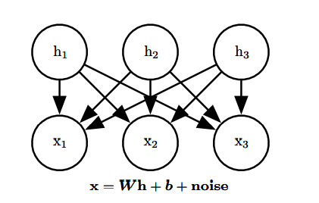
Linear factor Models
linear factor models are used as building blocks of mixture modelsor of larger, deep probabilistic models
A linear factor model is defined by the use of a stochastic linear decoder function that generates x by adding noise to a linear transformation of h
allow us to discover explanatory factors that have a simple joint distribution
A linear factor model describes the data-generation process as follows.
we sample the explanatory factors h from a distribution
h ∼ p(h)
From the above Diagram, the observed data vector x is obtained by a linear combination of independent latent factors h, plus some noise

Slide 7
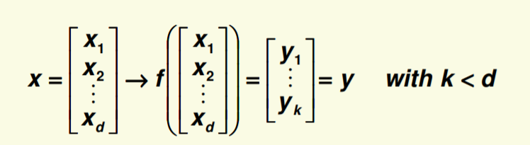
Linear factor Models
Different models, such as probabilistic PCA, factor analysis or ICA, make different choices about the form of the noise and of the prior p(h).
where p(h) is a factorial distribution, with p(h) = Π i p(hi),
Next we sample the real-valued observable variables given the factors x = W h + b + noise,
where the noise is typically Gaussian and diagonal
Dimensionality Reduction:
High dimensionality is challenging and redundant
It is natural to try to reduce dimensionality
We reduce the dimensionality by feature combination i.e., combine old features X to create new features Y

Slide 8
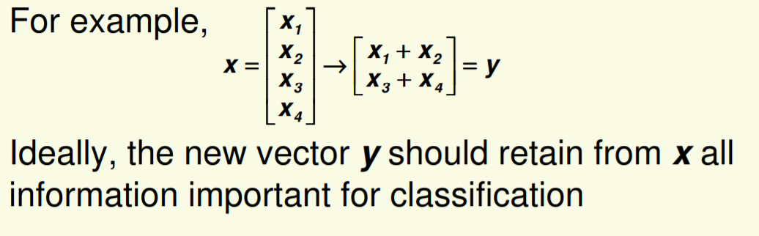
Dimensionality Reduction
An important machine learning method for dimensionality reduction is called Principal Component Analysis.

Slide 9
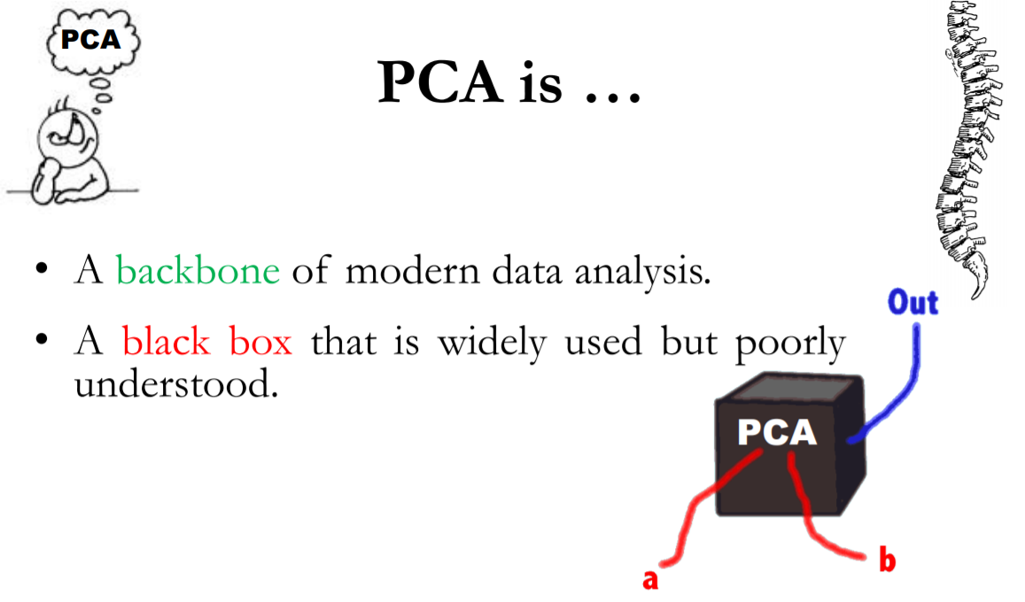
Principle Component Analysis - PCA
It is a method that uses simple matrix operations from linear algebra and statistics to calculate a projection of the original data into the same number or fewer dimensions.
t can be thought of as a projection method where data with m-columns (features) is projected into a subspace with m or fewer columns, whilst retaining the essence of the original data.
PCA is an operation applied to a dataset, represented by an n x m matrix A that results in a projection of A which we will call B.
Image Source: http://www.sci.utah.edu/~shireen/pdfs/tutorials/Elhabian_PCA09.pdf

Slide 10
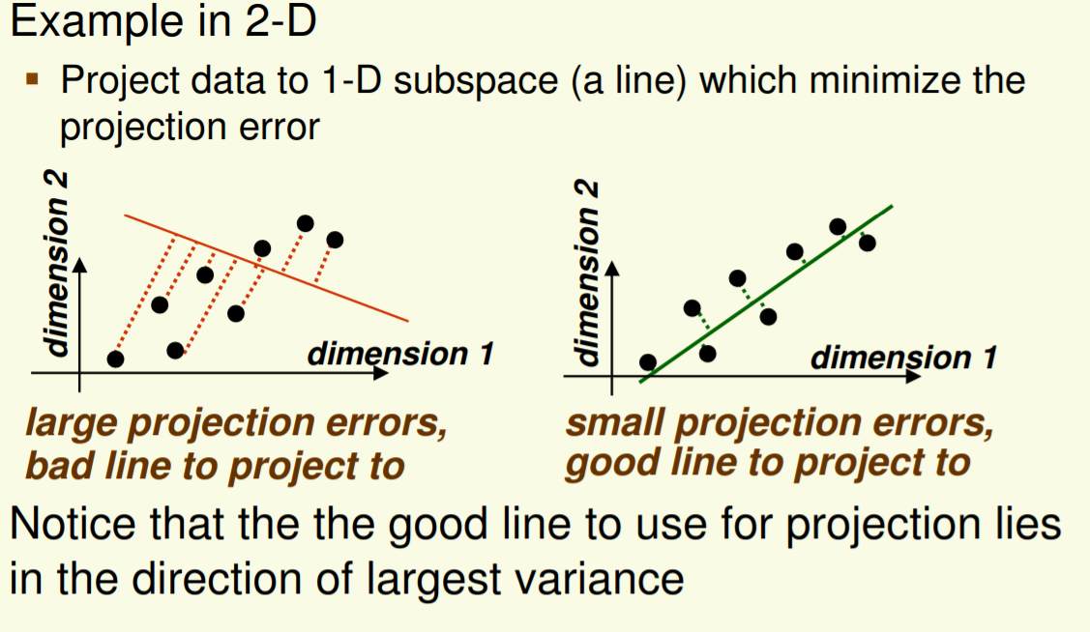
Principle Component Analysis - PCA
It is a mathematical tool from applied linear algebra.
It is a simple, non-parametric method of extracting relevant information from confusing data sets.
It provides a roadmap for how to reduce a complex data set to a lower dimension.
Main idea: seek most accurate data representation in a lower dimensional space
Image Source: https://www.csd.uwo.ca/~oveksler/Courses/CS434a_541a/Lecture7.pdf

Slide 11
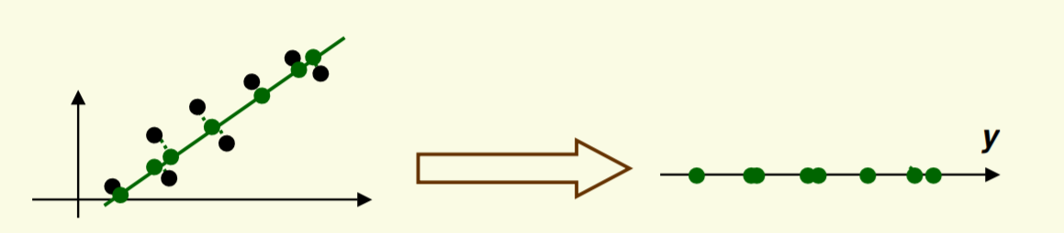
Principle Component Analysis - PCA
After the data is projected on the best line, need to transform the coordinate system to get 1D representation for vector y
Note that new data y has the same variance as old data x in the direction of the green line PCA preserves largest variances in the data.
Image Source: https://www.csd.uwo.ca/~oveksler/Courses/CS434a_541a/Lecture7.pdf

Slide 12
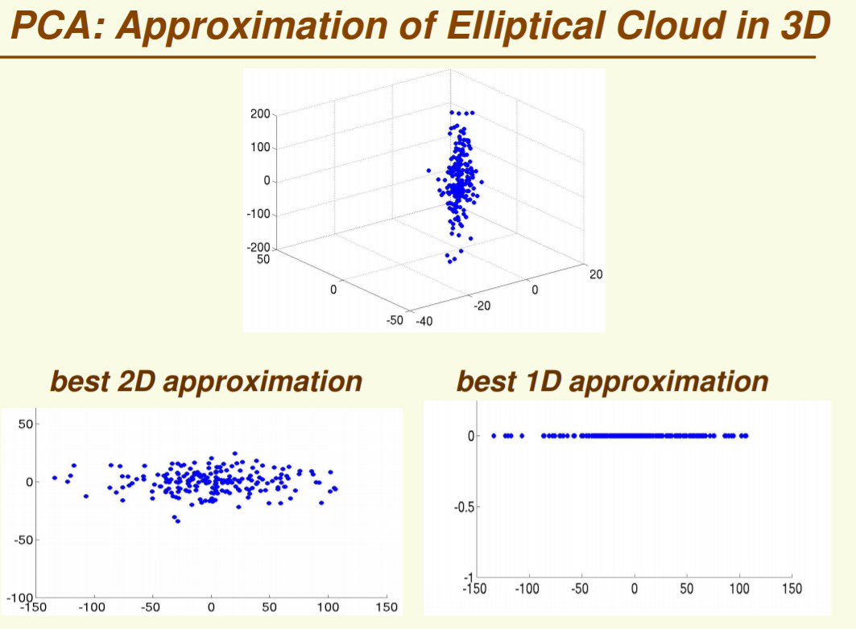
Principle Component Analysis - PCA

Slide 13
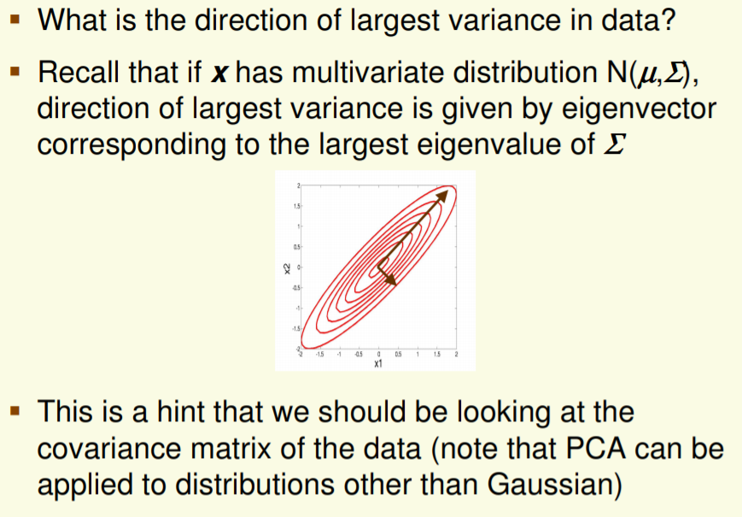
Principle Component Analysis - PCA

Slide 14
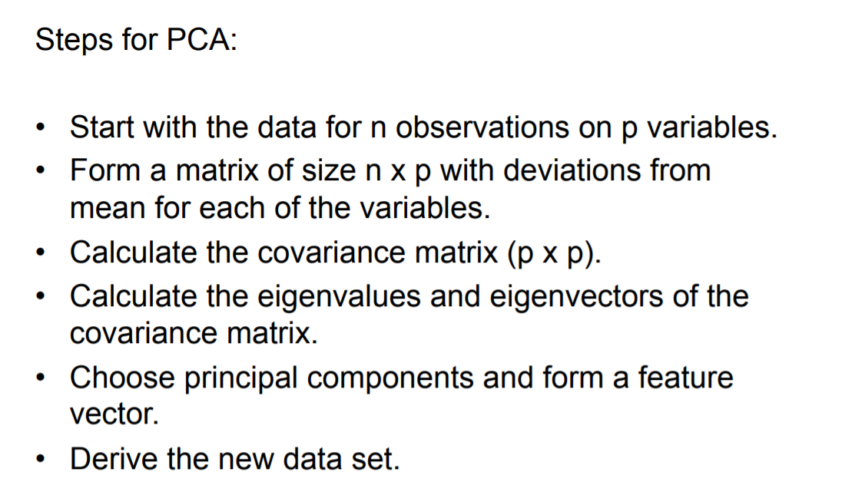
Principle Component Analysis -STEPs

Slide 15
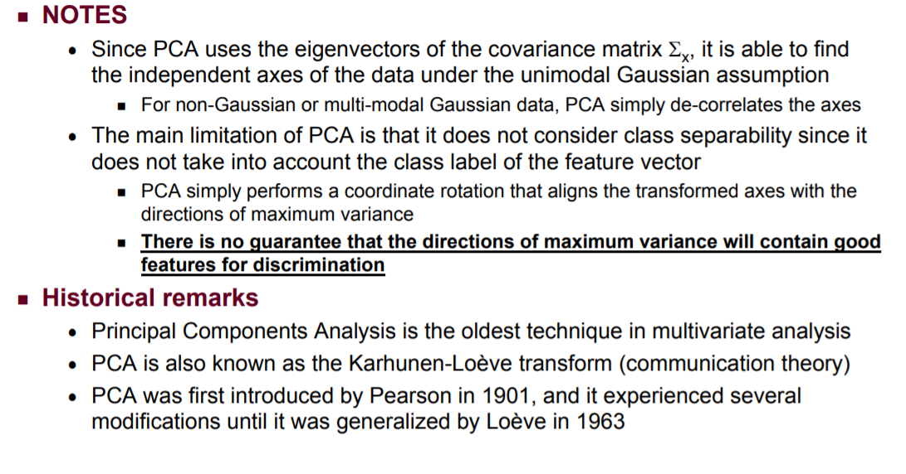
Principle Component Analysis -STEPs

Slide 16
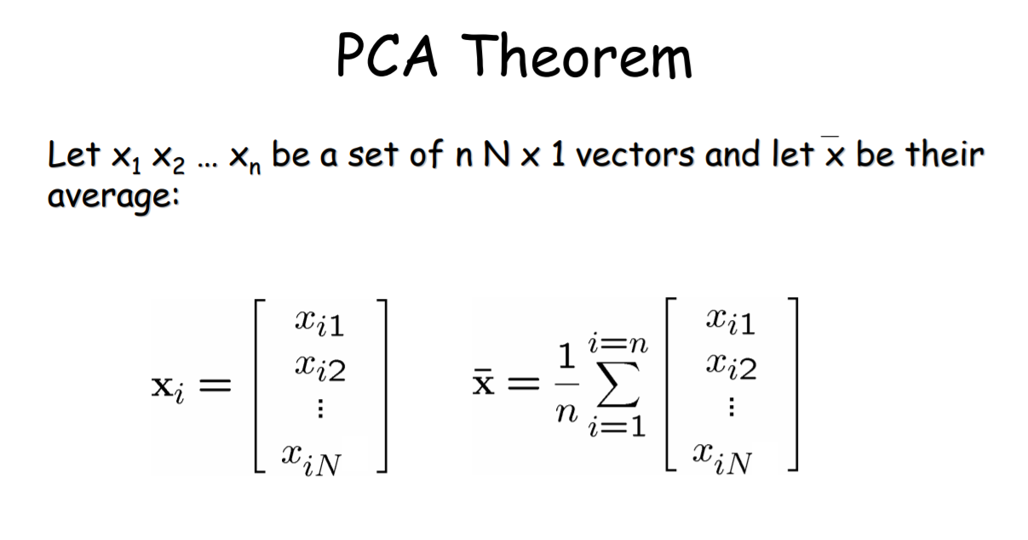
Principle Component Analysis -PCA
By finding the eigenvalues and eigenvectors of the covariance matrix, we find that the eigenvectors with the largest eigenvalues correspond to the dimensions that have the strongest correlation in the dataset. This is the principal component.
PCA is a useful statistical technique that has found application in: – fields such as face recognition and image compression – finding patterns in data of high dimension.

Slide 17
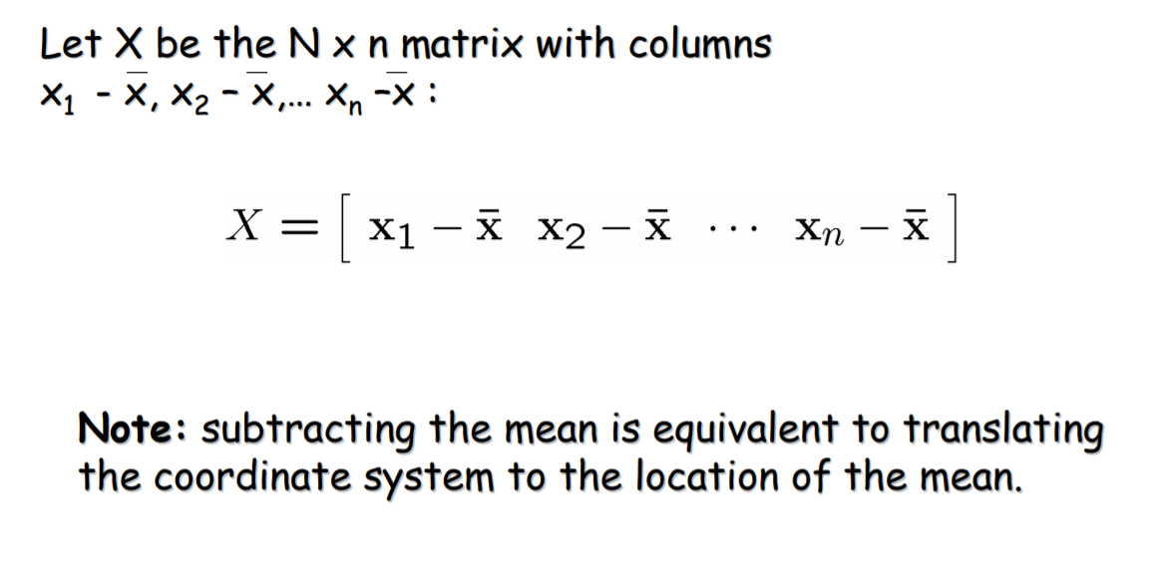
Principle Component Analysis

Slide 18
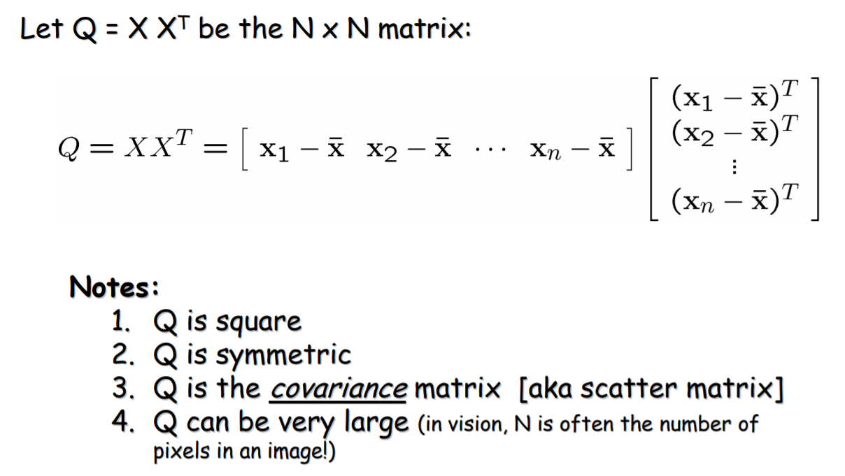
Principle Component Analysis

Slide 19
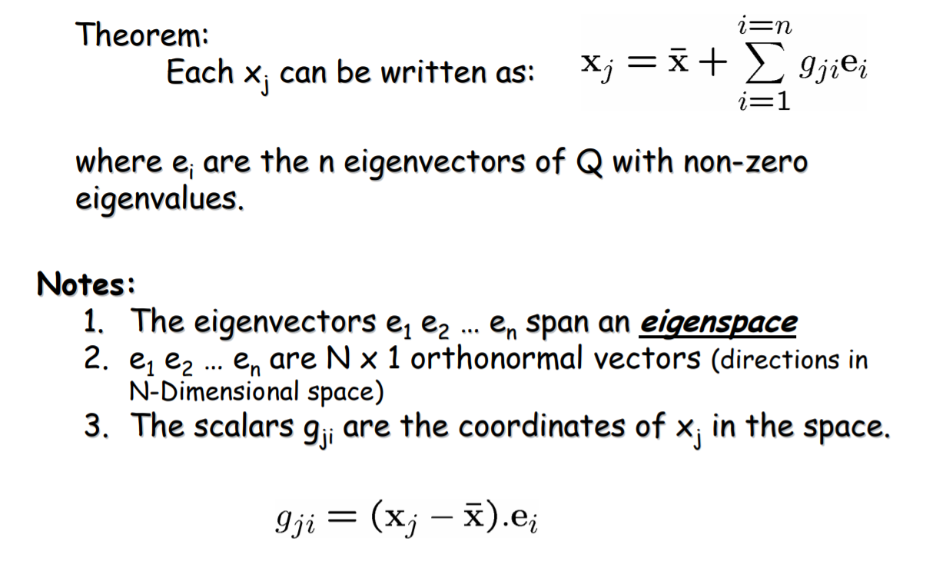
Principle Component Analysis

Slide 20
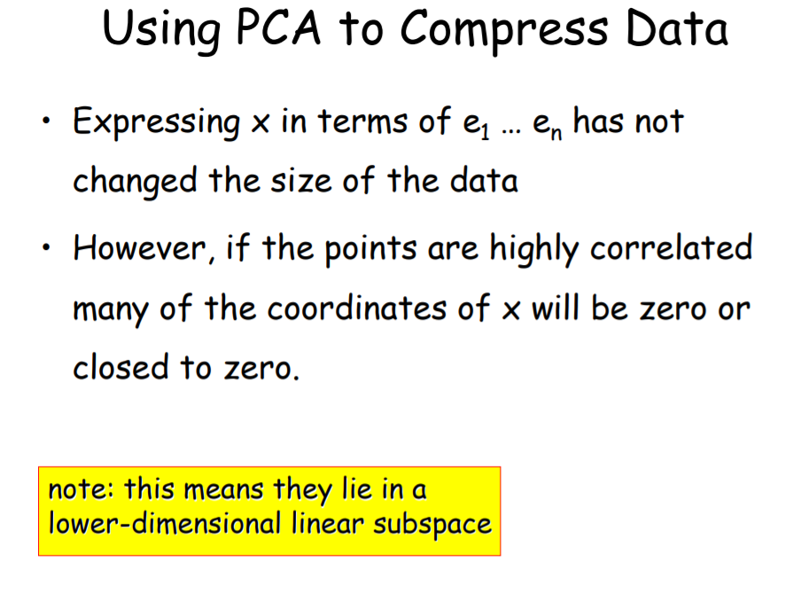
Principle Component Analysis

Slide 21
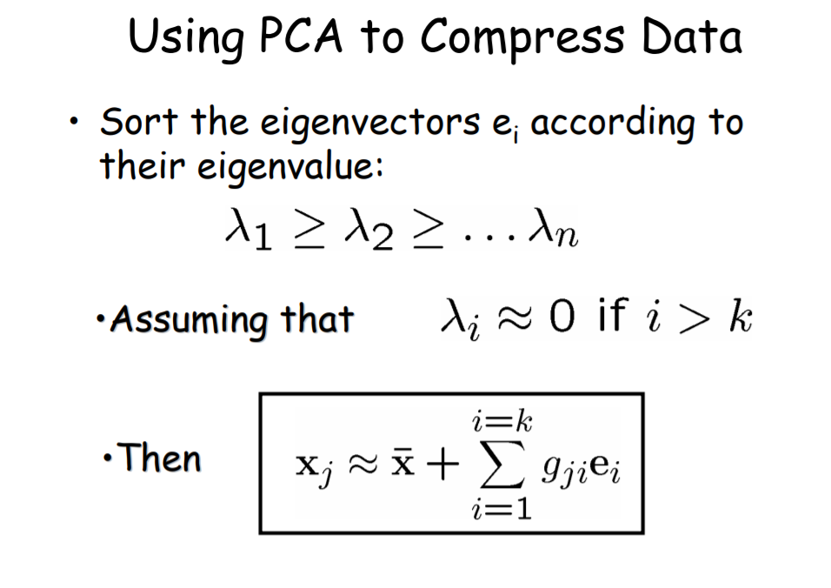
Principle Component Analysis

Slide 22
Principle Component Analysis - Advantages
Removes Correlated Features:
In a real world scenario, it is very common that we get thousands of features in our dataset. You cannot run your algorithm on all the features as it will reduce the performance of your algorithm and it will not be easy to visualize that many features in any kind of graph. Hence the data set should be reduced.
We need to find out the correlation among the features (correlated variables). Finding correlation manually in thousands of features is nearly impossible, frustrating and time-consuming. PCA performs this task effectively
After implementing the PCA on your dataset, all the Principal Components are independent of one another. There is no correlation among them.
2. Improves Algorithm Performance:
With so many features, the performance of your algorithm will drastically degrade. PCA is a very common way to speed up your Machine Learning algorithm by getting rid of correlated variables which don't contribute in any decision making. The training time of the algorithms reduces significantly with less number of features.
So, if the input dimensions are too high, then using PCA to speed up the algorithm is a reasonable choice.

Slide 23
Principle Component Analysis - Advantages & Disadvantages
3. Reduces Overfitting: Overfitting mainly occurs when there are too many variables in the dataset. So, PCA helps in overcoming the overfitting issue by reducing the number of features. 4. Improves Visualization: It is very hard to visualize and understand the data in high dimensions. PCA transforms a high dimensional data to low dimensional data (2 dimension) so that it can be visualized easily. We can use 2D Scree Plot to see which Principal Components result in high variance and have more impact as compared to other Principal Components.
Disadvantages of Principal Component Analysis 1. Independent variables become less interpretable: After implementing PCA on the dataset, your original features will turn into Principal Components. Principal Components are the linear combination of your original features. Principal Components are not as readable and interpretable as original features. 2. Data standardization is must before PCA: You must standardize your data before implementing PCA, otherwise PCA will not be able to find the optimal Principal Components.

Slide 24
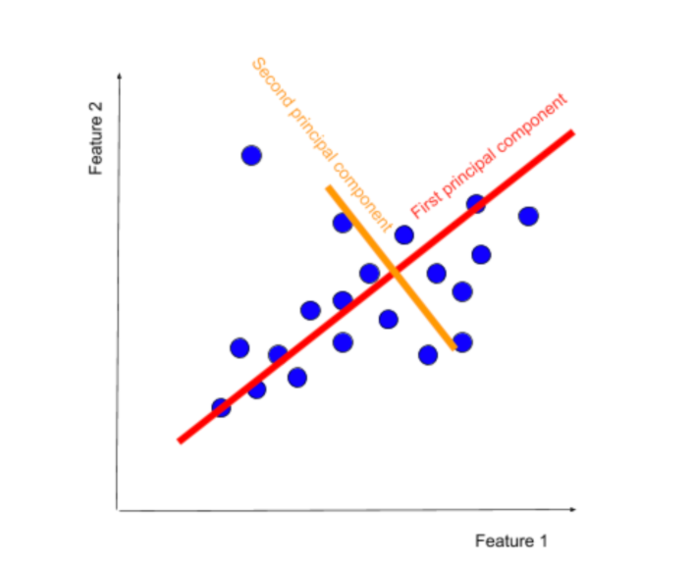
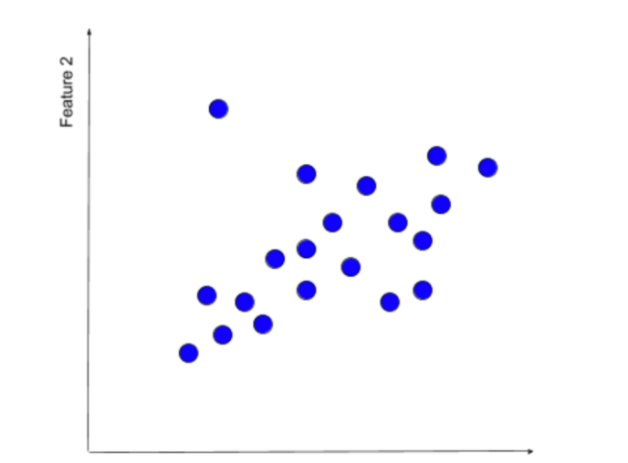
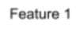
Principle Component Analysis - Advantages & Disadvantages
Disadvantages of Principal Component Analysis 3. Information Loss: Although Principal Components try to cover maximum variance among the features in a dataset, if we don't select the number of Principal Components with care, it may miss some information as compared to the original list of features.

Slide 25
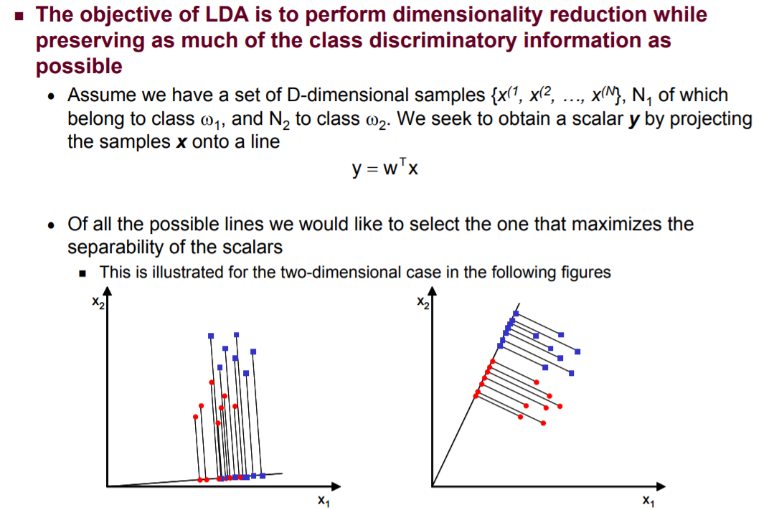
Linear Discriminative Analysis - LDA
Content & Image Source: http://www.facweb.iitkgp.ac.in/~sudeshna/courses/ml08/lda.pdf

Slide 26
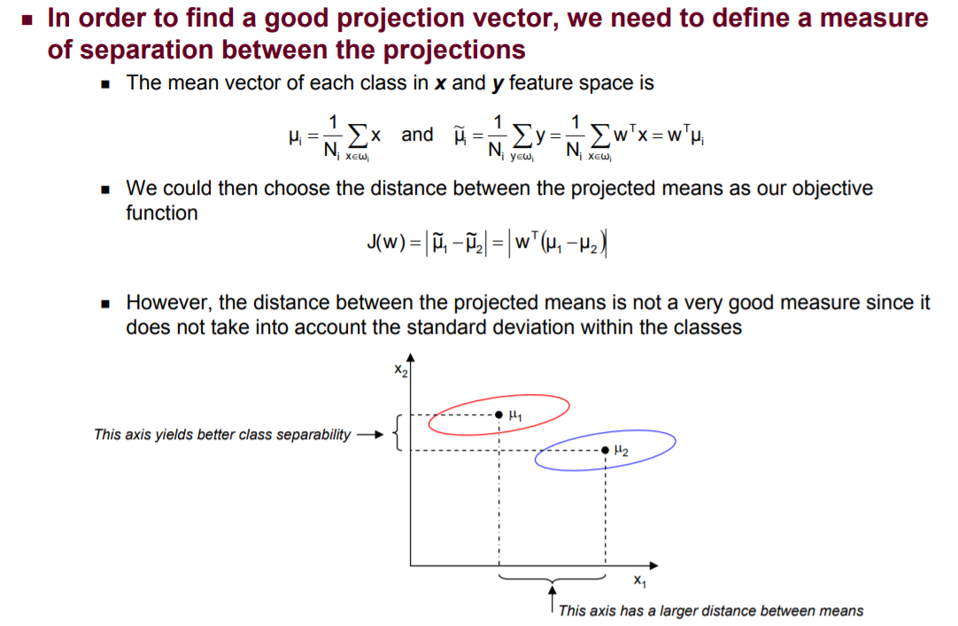
Linear Discriminative Analysis - LDA
Content & Image Source: http://www.facweb.iitkgp.ac.in/~sudeshna/courses/ml08/lda.pdf

Slide 27
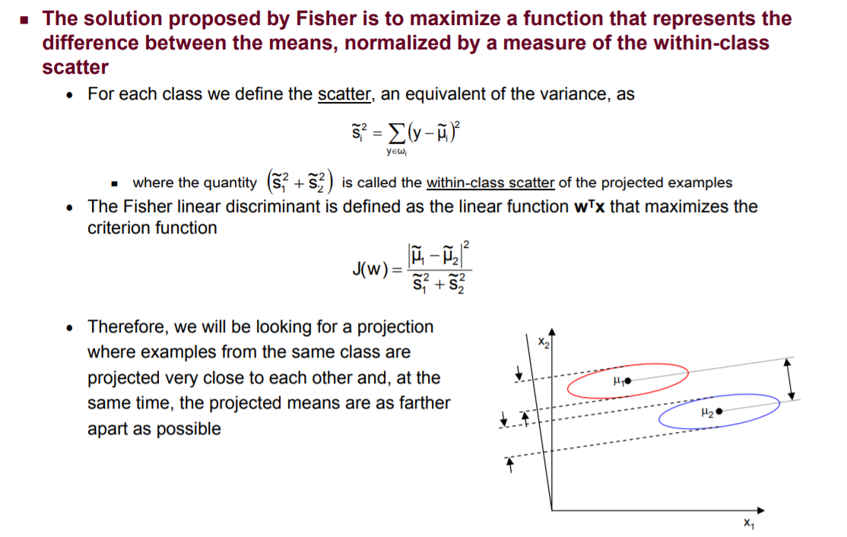
Linear Discriminative Analysis - LDA
Content & Image Source: http://www.facweb.iitkgp.ac.in/~sudeshna/courses/ml08/lda.pdf

Slide 28
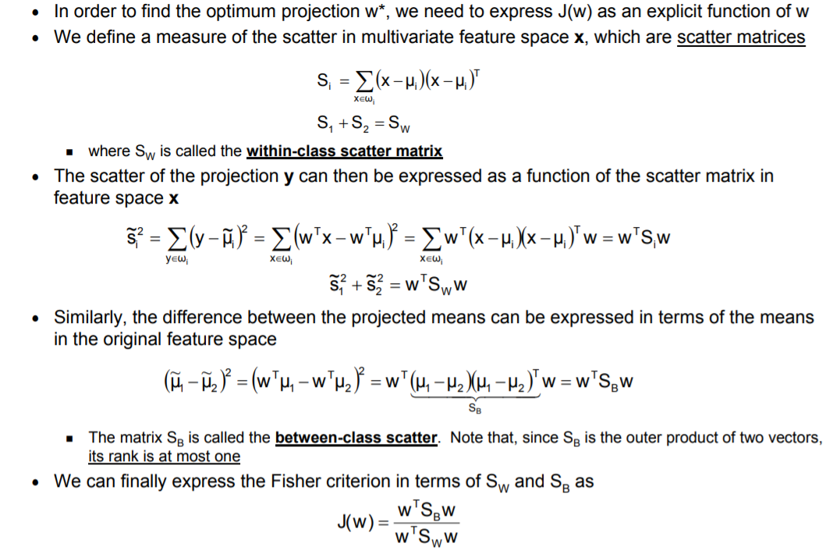
Linear Discriminative Analysis - LDA
Content & Image Source: http://www.facweb.iitkgp.ac.in/~sudeshna/courses/ml08/lda.pdf

Slide 29
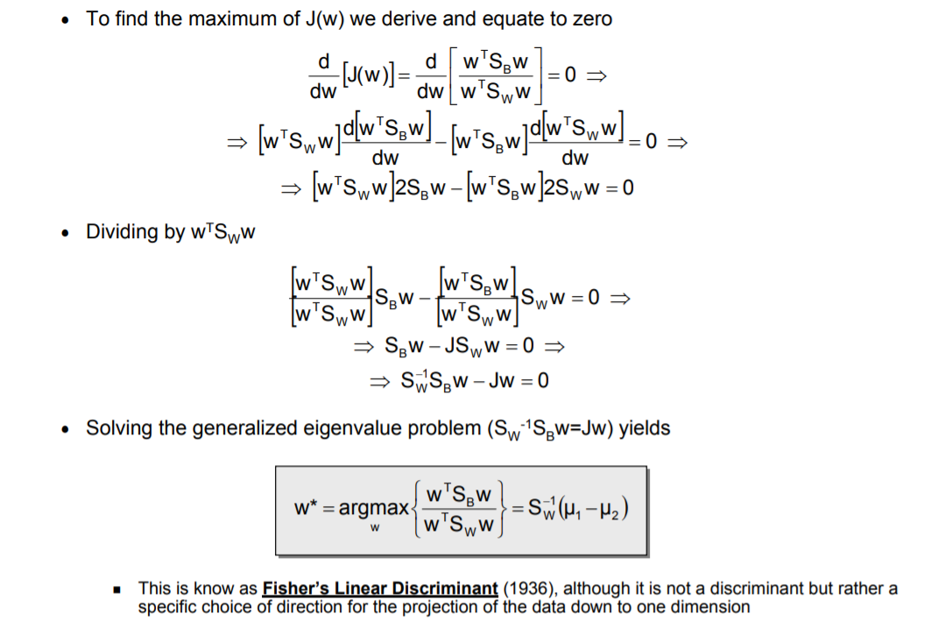
Linear Discriminative Analysis - LDA
Content & Image Source: http://www.facweb.iitkgp.ac.in/~sudeshna/courses/ml08/lda.pdf

Slide 30
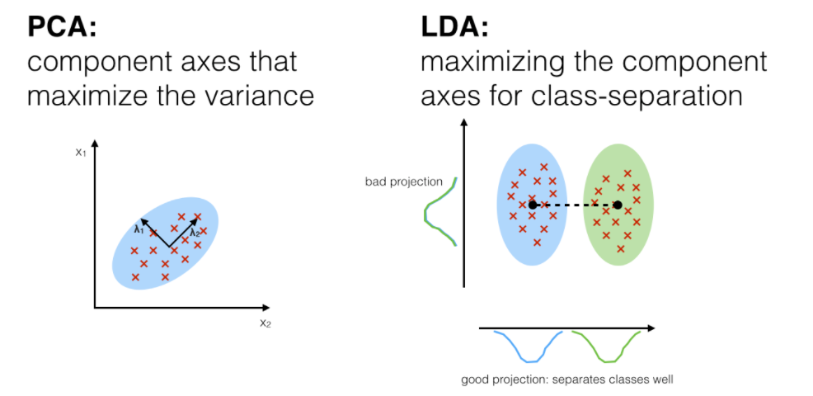
PCA Vs LDA
Content & Image Source: https://sebastianraschka.com/Articles/2014_python_lda.html

Slide 31
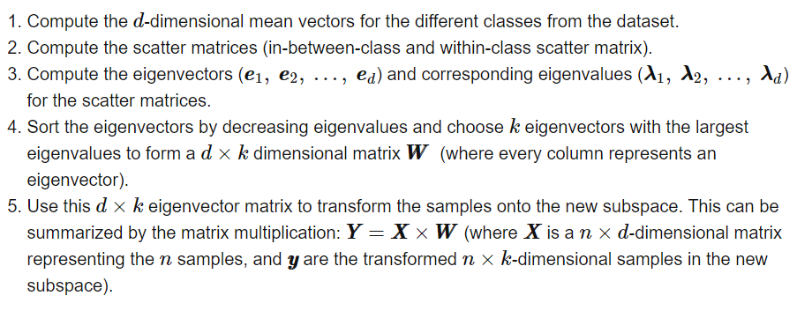
LDA in 5simple steps
Content & Image Source: https://sebastianraschka.com/Articles/2014_python_lda.html

Slide 32
LDA – Pros & Cons
Advantages of LDA:
Simple prototype classifier: Distance to the class mean is used, it’s simple to interpret.
Decision boundary is linear: It’s simple to implement and the classification is robust.
Dimension reduction: It provides informative low-dimensional view on the data, which is both useful for visualization and feature engineering.
Shortcomings of LDA:
Linear decision boundaries may not adequately separate the classes. Support for more general boundaries is desired.
In a high-dimensional setting, LDA uses too many parameters. A regularized version of LDA is desired.
Support for more complex prototype classification is desired.
Content & Image Source: https://yangxiaozhou.github.io/data/2019/10/02/linear-discriminant-analysis.html

Slide 33
Manifold Learning
Manifold learning for dimensionality reduction has recently gained much attention to assist image processing tasks such as segmentation, registration, tracking, recognition, and computational anatomy.
The drawbacks of PCA in handling dimensionality reduction problems for non-linear weird and curved shaped surfaces necessitated development of more advanced algorithms like Manifold Learning.
There are different variants of Manifold Learning that solves the problem of reducing data dimensions and feature-sets obtained from real world problems representing uneven weird surfaces by sub-optimal data representation.
This kind of data representation selectively chooses data points from a low-dimensional manifold that is embedded in a high-dimensional space in an attempt to generalize linear frameworks like PCA.
Content & Image Source: https://techairesearch.com/dimensionality-reduction-pca-ica-and-manifold-learning/

Slide 34
Manifold Learning – Continued.,
Manifolds give a look of flat and featureless space that behaves like Euclidean space. Manifold learning problems are unsupervised where it learns the high-dimensional structure of the data from the data itself, without the use of predetermined classifications and loss of importance of information regarding some characteristic of the original variables.
The goal of the manifold-learning algorithms is to recover the original domain structure, up to some scaling and rotation. The nonlinearity of these algorithms allows them to reveal the domain structure even when the manifold is not linearly embedded. It uses some scaling and rotation for this purpose.
Manifold learning algorithms are divided in to two categories:
Global methods: Allows high-dimensional data to be mapped from high-dimensional to low-dimensional such that the global properties are preserved. Examples include Multidimensional Scaling (MDS), Isomaps covered in the following sections.
Local methods: Allows high-dimensional data to be mapped to low dimensional such that local properties are preserved. Examples are Locally linear embedding (LLE), Laplacian eigenmap (LE), Local tangent space alignment (LSTA), Hessian Eigenmapping (HLLE)
Content & Image Source: https://techairesearch.com/dimensionality-reduction-pca-ica-and-manifold-learning/

Slide 35
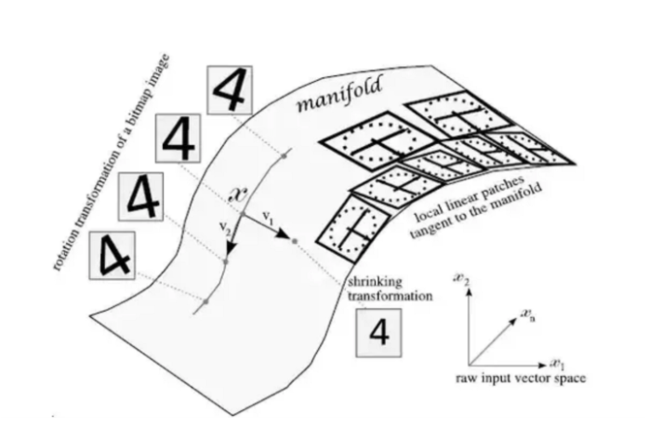
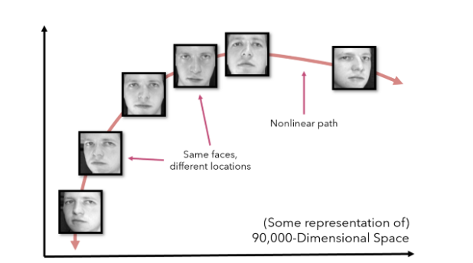
Manifold Learning – Continued.,
consider 300 by 300 pixel headshots. Under perfect conditions, each of the images would be centered perfectly, but in reality, there are many additional degrees of freedom to consider, such as lighting or the tilt of the face. If we were to treat a headshot as a point in 90,000 dimensional space, changing various effects like tilting the head or looking in a different direction move it nonlinearly through space, even though it is the same object with the same class.
PCA attempts to create several linear hyperplanes to represent dimensions.
Manifold learning attempts to learn manifolds, which are smooth, curved surfaces within the multidimensional space. As in the image above, these are often formed by subtle transformations on an image that would otherwise fool PCA.
Content & Image Source: https://towardsdatascience.com/manifold-learning-t-sne-lle-isomap-made-easy-42cfd61f5183/

Slide 36
Manifold Learning – Continued.,
PCA attempts to create several linear hyperplanes to represent dimensions.
Manifold learning attempts to learn manifolds, which are smooth, curved surfaces within the multidimensional space. As in the image above, these are often formed by subtle transformations on an image that would otherwise fool PCA.
Content & Image Source: https://towardsdatascience.com/manifold-learning-t-sne-lle-isomap-made-easy-42cfd61f5183/

Slide 37
Manifold Learning – Continued.,
‘local linear patches’ that are tangent to the manifold can be extracted.
These patches are usually in abundance & that they can accurately represent the manifold.
Since these manifolds are not modelled by any one mathematical function but by several small linear patches, these linear neighborhoods can model any manifold.
The fundamental assumptions or aspects of manifold learning algorithms:
There exist nonlinear relationships in the data that can be modelled through manifolds — surfaces that span multiple dimensions, are smooth, and not too complex. The manifolds are continuous.
It is not important to maintain the multi-dimensional shape of data. Instead of ‘flattening’ or ‘projecting’ it (as with PCA) with specific directions to maintain the general shape of the data, it is alright to perform more complex manipulations like unfolding a coiled strip or flipping a sphere inside out.
The best method to model manifolds is to treat the curved surface as being composed of several neighborhoods. If each data point manages to preserve the distance not with all the other points but only the ones close to it, the geometric relationships can be maintained in the data.
Content & Image Source: https://towardsdatascience.com/manifold-learning-t-sne-lle-isomap-made-easy-42cfd61f5183/

Slide 38
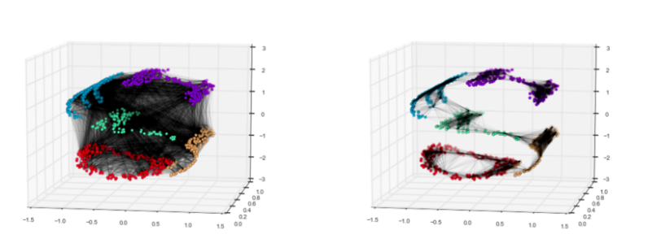
Manifold Learning – Continued.,
On the left is a more PCA-like approach towards preserving the shape of the data, where each point is connected to each other.
On the right, however, is an approach in which only the distance between neighborhoods of data points are valued.
Content & Image Source: https://towardsdatascience.com/manifold-learning-t-sne-lle-isomap-made-easy-42cfd61f5183/

Slide 39
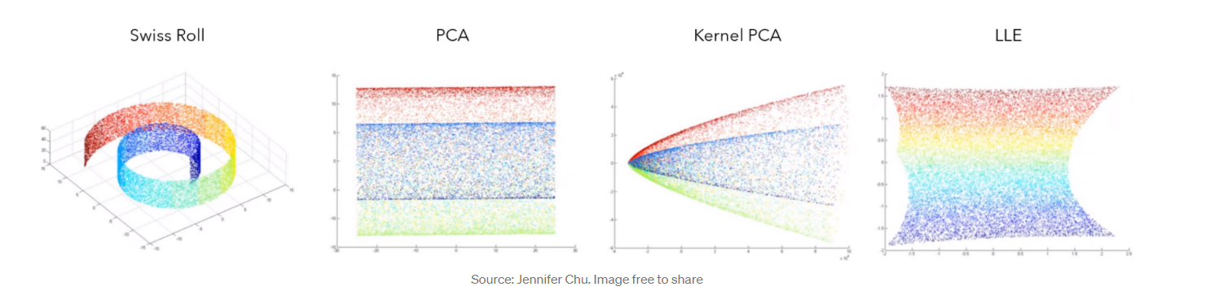
Manifold Learning – Continued.,
On the Swiss Roll dataset, PCA and even specialized variations like Kernel PCA fail to capture the gradient of values. Locally Linear Embeddings (LLE), a manifold learning algorithm, on the other hand, is able to.
Content & Image Source: https://towardsdatascience.com/manifold-learning-t-sne-lle-isomap-made-easy-42cfd61f5183/

Slide 40
Manifold Learning – Continued.,
Three popular manifold learning algorithms:
IsoMap (Isometric Mapping)
Locally Linear Embeddings &
t-SNE.
IsoMap :
Isomap seeks a lower-dimensional representation that maintains ‘geodesic distances’ between the points. A geodesic distance is a generalization of distance for curved surfaces. Hence, instead of measuring distance in pure Euclidean distance with the Pythagorean theorem-derived distance formula, Isomap optimizes distances along a discovered manifold.
Content & Image Source: https://towardsdatascience.com/manifold-learning-t-sne-lle-isomap-made-easy-42cfd61f5183/

Slide 41
Manifold Learning – Continued.,
Locally Linear Embeddings (LLE) :
Locally Linear Embeddings use a variety of tangent linear patches (as demonstrated with the diagram above) to model a manifold. It can be thought of as performing a PCA on each of these neighborhoods locally, producing a linear hyperplane, then comparing the results globally to find the best nonlinear embedding.
The goal of LLE is to ‘unroll’ or ‘unpack’ in distorted fashion the structure of the data, so often LLE will tend to have a high density in the center with extending rays..
t-SNE :
t-SNE is one of the most popular choices for high-dimensional visualization, and stands for t-distributed Stochastic Neighbor Embeddings. The algorithm converts relationships in original space into t-distributions, or normal distributions with small sample sizes and relatively unknown standard deviations. This makes t-SNE very sensitive to the local structure, a common theme in manifold learning. It is considered to be the go-to visualization method because of many advantages it possesses
Content & Image Source: https://towardsdatascience.com/manifold-learning-t-sne-lle-isomap-made-easy-42cfd61f5183/

Slide 42
Manifold Learning – Continued.,
Advantages of t-SNE :
It is able to reveal the structure of the data at many scales.
It reveals data that lies in multiple manifolds and clusters
Has a smaller tendency to cluster points at the center.
Points to Remember:
PCA fails to model nonlinear relationships because it is linear.
Nonlinear relationships appear in datasets often because external forces like lighting or the tilt can move a data point of the same class nonlinearly through Euclidean space.
Manifold learning attempts to generalize PCA to perform dimensionality reduction on all sorts of dataset structures, with the main idea that manifolds, or curved, continuous surfaces, should be modelled by preserving and prioritizing local over global distance.
Isomap tries to preserve geodesic distance, or distance measured not in Euclidean space but on the curved surface of the manifold.
LLE can be thought of as representing the manifold as several linear patches, in which PCA is performed on.
t-SNE takes more of an ‘extract’ approach opposed to an ‘unrolling’ approach, but still, like other manifold learning algorithms, prioritizes the preservation of local distances by using probability and t-distributions.
Content & Image Source: https://towardsdatascience.com/manifold-learning-t-sne-lle-isomap-made-easy-42cfd61f5183/

Slide 43
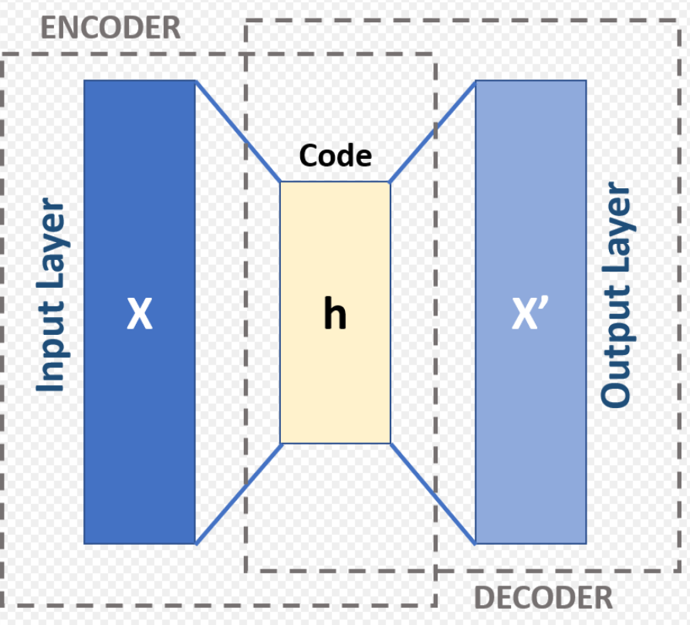
AutoEncoders
An autoencoder is a type of artificial neural network used to learn efficient coding's of unlabeled data.
It is based on unsupervised learning
The encoding is validated and refined by attempting to regenerate the input from the encoding.
The autoencoder learns a representation (encoding) for a set of data, typically for dimensionality reduction, by training the network to ignore insignificant data (“noise”).
Content & Image Source: Https://www.Autoencoder schema - Autoencoder - Wikipedia

Slide 44
AutoEncoders
An Autoencoder attempts to encode the data by compressing it into the lower dimensions (bottleneck layer or code)
Then it decodes the data to reconstruct the original input.
The bottleneck layer (or code) holds the compressed representation of the input data
the number of output units must be equal to the number of input units
The encoder encodes the provided data into a lower dimension which is the size of the bottleneck layer and the decoder decodes the compressed data into its original form
The number of neurons in the layers of the encoder will be decreasing as we move on with further layers, whereas the number of neurons in the layers of the decoder will be increasing as we move on with further layers.
The encoder contains 32, 16, and 7 units in each layer respectively and the decoder contains 7, 16, and 32 units in each layer respectively
The code size/ the number of neurons in bottle-neck must be less than the number of features in the data
Before entering the data into the Autoencoder, the data must be scaled between 0 and 1 using MinMaxScaler
Content & Image Source: Https://www.Autoencoder schema - Autoencoder - Wikipedia

Slide 45
AutoEncoders
When we use Autoencoders for dimensionality reduction we’ll be extracting the bottleneck layer and thus reducing the dimensions. This process can be regarded as feature extraction
Types of Autoencoders
Deep Autoencoder
Sparse Autoencoder
Under complete Autoencoder
Variational Autoencoder
LSTM Autoencoder
Hyperparameters of an Autoencoder
Code size or the number of units in the bottleneck layer
Input and output size, which is the number of features in the data
Number of neurons or nodes per layer
Number of layers in encoder and decoder
Activation function
Optimization function
Content & Image Source: https:// File:Autoencoder structure.png - Wikimedia Commons

Slide 46
AutoEncoders
Training:
Geoffrey Hinton developed the deep belief network technique for training many-layered deep autoencoders.
His method involves treating each neighboring set of two layers as a restricted Boltzmann machine, then using backpropagation to fine-tune the results
Joint training (i.e. training the whole architecture together with a single global reconstruction objective to optimize) would be better for deep auto-encoders]
However, the success of joint training depends heavily on the regularization strategies adopted.
Applications of Autoencoders :
Dimensionality reduction
Anomaly detection
Image denoising
Image compression
Image generation
Content & Image Source: https:// File:Autoencoder structure.png - Wikimedia Commons

Slide 47
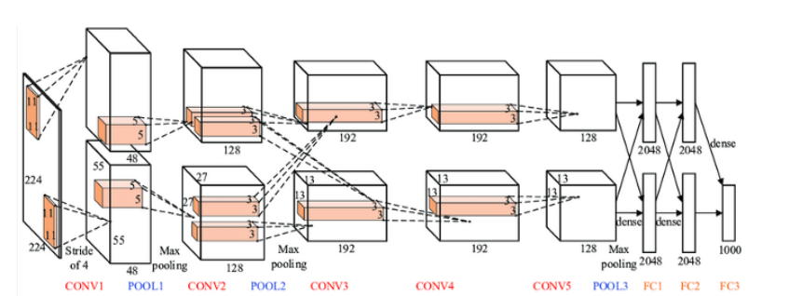
Alex Net
Alexnet model was proposed in 2012 in the research paper named Imagenet Classification with Deep Convolution Neural Network by Alex Krizhevsky and his colleagues.
AlexNet Architecture
Content & Image Source: https:// File:Autoencoder structure.png - Wikimedia Commons

Slide 48
Alex Net
The Alexnet has eight layers with learnable parameters
The model has five layers with a combination of max pooling followed by 3 fully connected layers
The fully connected layers use Relu activation except the output layer
They found out that using the Relu as an activation function accelerated the speed of the training process by almost six times.
They also used the dropout layers, which prevented the model from overfitting.
The model is trained on the Imagenet dataset. The Imagenet dataset has arounf 14 million images across a 1000 classes.
The input to this model is the images of size 227X227X3
The first convolution layer with 96 filters of size 11X11 with stride 4
The activation function used in this layer is relu. The output feature map is 55X55X96
Next, we have the first Maxpooling layer, of size 3X3 and stride 2
Next the filter size is reduced to 5X5 and 256 such filtersare added
The stride value is 1 and padding 2. The activation function used is again relu. The output size we get is 27X27X256
Content & Image Source: https:// File:Autoencoder structure.png - Wikimedia Commons

Slide 49
Alex Net
Next we have a max-pooling layer of size 3X3 with stride 2. The resulting feature map size is 13X13X256
The third convolution operation with 384 filters of size 3X3 stride 1 and also padding 1is done next. In this stage the activation function used is relu. The output feature map is of shape 13X13X384
Then the fourth convolution operation with 384 filters of size 3X3. The stride value along with the padding is 1.The output size remains unchanged as 13X13X384.
After this, we have the final convolution layer of size 3X3 with 256 such filters. The stride and padding are set to 1,also the activation function is relu. The resulting feature map is of shape 13X13X256
If we look at the architecture now, the number of filters is increasing as we are going deeper. Hence more features are extracted as we move deeper into the architecture. Also, the filter size is reducing, which means a decrease in the feature map shape.
Content & Image Source: https:// File:Autoencoder structure.png - Wikimedia Commons

Slide 50
Alex Net
Points to Remember:
It has 8 layers with learnable parameters.
The input to the Model is RGB images.
It has 5 convolution layers with a combination of max-pooling layers.
Then it has 3 fully connected layers.
The activation function used in all layers is Relu
It has two Dropout layers.
The activation function used in the output layer is Softmax.
The total number of parameters in this architecture is 62.3 million.
Content & Image Source: https:// File:Autoencoder structure.png - Wikimedia Commons

Slide 51
VGG-16 Net
The major shortcoming of too many hyper-parameters of AlexNet was solved by VGG Net by replacing large kernel-sized filters (11 and 5 in the first and second convolution layer, respectively) with multiple 3×3 kernel-sized filters one after another.
The architecture developed by Simonyan and Zisserman was the 1st runner up of the Visual Recognition Challenge of 2014.
The architecture consist of 3*3 Convolutional filters, 2*2 Max Pooling layer with a stride of 1.
Padding is kept same to preserve the dimension.
There are 16 layers in the network where the input image is RGB format with dimension of 224*224*3, followed by 5 pairs of Convolution(filters: 64, 128, 256,512,512) and Max Pooling.
The output of these layers is fed into three fully connected layers and a softmax function in the output layer.
In total there are 138 Million parameters in VGG Net
Content & Image Source: https:// File:Autoencoder structure.png - Wikimedia Commons

Slide 52
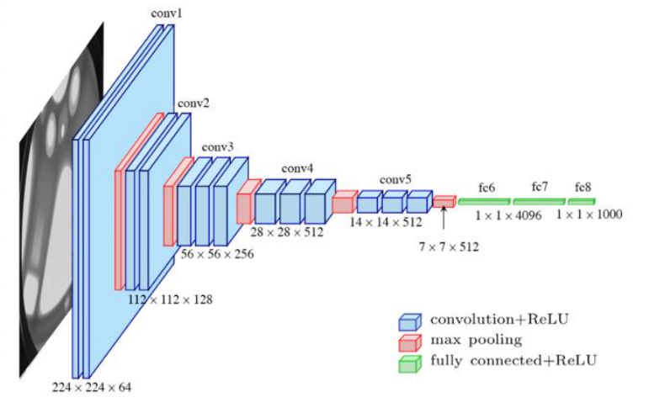
VGG-16 Net
Drawbacks of VGG Net:
1. Long training time
2. Heavy model
3.Computationally expensive
4. Vanishing/exploding gradient problem
Content & Image Source: https:// File:Autoencoder structure.png - Wikimedia Commons

Slide 53
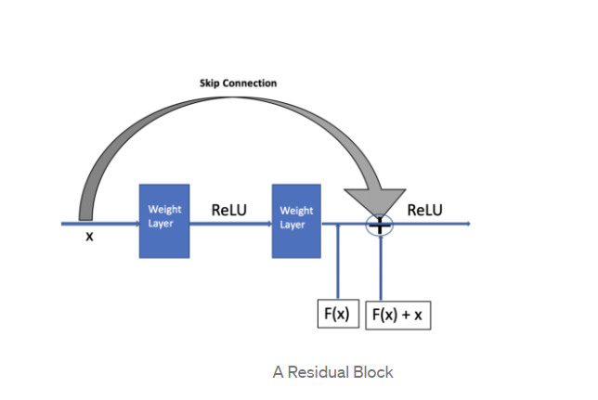
ResNet
ResNet, the winner of ILSVRC-2015 competition is a deep network with over 100 layers.
Residual networks (ResNet) is similar to VGG nets however with a sequential approach they also use “Skip connections” and “batch normalization” that helps to train deep layers without hampering the performance.
After VGG Nets, as CNNs were going deep, it was becoming hard to train them because of vanishing gradients problem that makes the derivate infinitely small.
Therefore, the overall performance saturates or even degrades.
The idea of skips connection came from highway network where gated shortcut connections were used
Content Source: https:// File:Autoencoder structure.png - Wikimedia Commons
Image Source: Understanding Residual Network (ResNet)Architecture | Analytics Vidhya

Slide 54
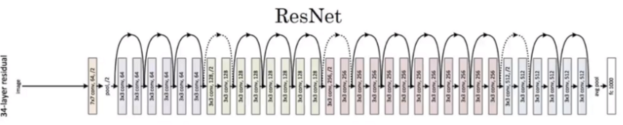
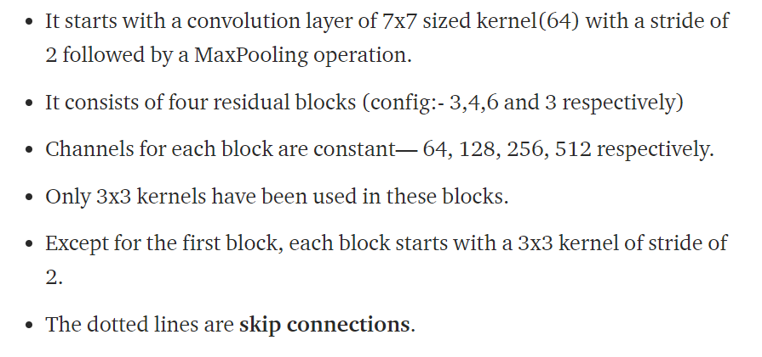
Image & Content Source: Understanding Residual Network (ResNet)Architecture | Analytics Vidhya

Slide 55
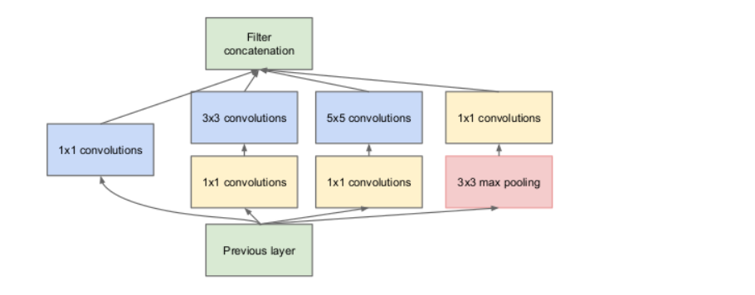
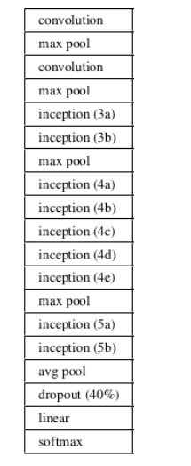
INCEPTION Net
Inception network also known as GoogleLe Net was proposed by developers at google in “Going Deeper with Convolutions” in 2014.
The motivation of InceptionNet comes from the presence of sparse features Salient parts in the image that can have a large variation in size.
Due to this, the selection of right kernel size becomes extremely difficult as big kernels are selected for global features and small kernels when the features are locally located.
Image & Content Source: https://www.analyticsvidhya.com/blog/2018/10/understanding-inception-network-from-scratch

Slide 56
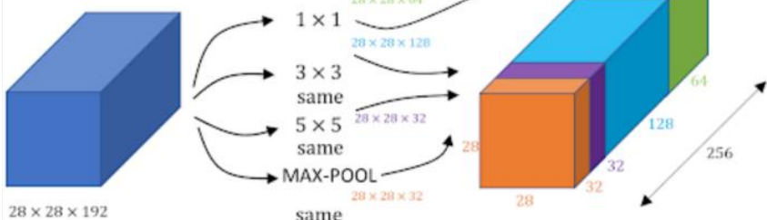
INCEPTION Net
The InceptionNets resolves this by stacking multiple kernels at the same level.
Typically it uses 5*5, 3*3 and 1*1 filters in one go.
For better understanding refer to the image below:.
Image & Content Source: https://www.analyticsvidhya.com/blog/2018/10/understanding-inception-network-from-scratch

Slide 57
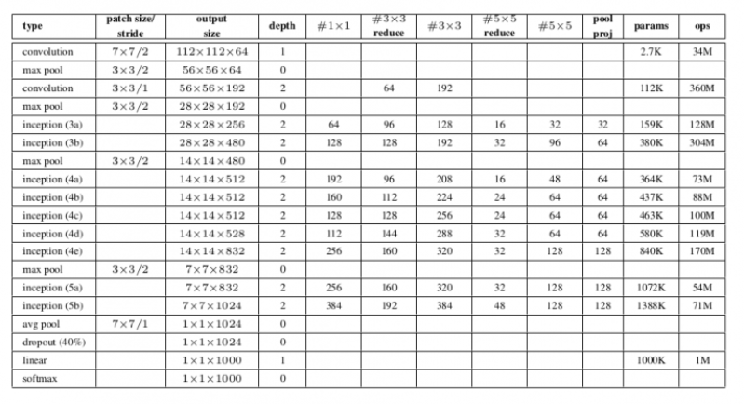
INCEPTION Net
Image & Content Source: https://www.analyticsvidhya.com/blog/2018/10/understanding-inception-network-from-scratch

Slide 58
Hyperparameter Optimization
Hyperparameter optimization in machine learning intends to find the hyperparameters of a given machine learning algorithm that deliver the best performance as measured on a validation set.
Hyperparameters, in contrast to model parameters, are set by the machine learning engineer before training.
The number of trees in a random forest is a hyperparameter while the weights in a neural network are model parameters learned during training
Hyperparameter optimization finds a combination of hyperparameters that returns an optimal model which reduces a predefined loss function and in turn increases the accuracy on given independent data
Hyperparameter Optimization methods
Manual Hyperparameter Tuning
Grid Search
Random Search
Bayesian Optimization
Gradient-based Optimization
Image & Content Source: https://www.kdnuggets.com/2020/05/hyperparameter-optimization-machine-learning-models.html

Slide 59
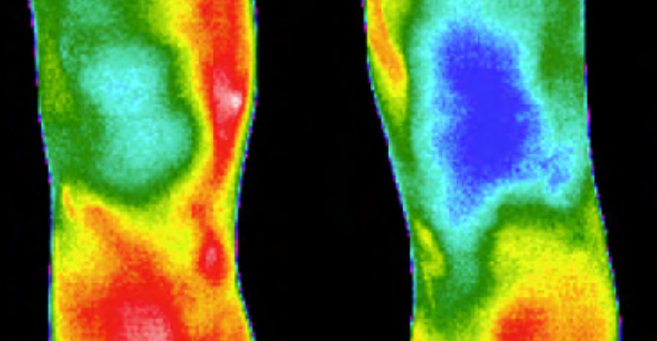
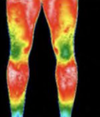
Application of Deep Learning Neural Network- Joint Detection
Rheumatoid Arthritis Present
DLNN MODEL
Rheumatoid Arthritis Absent
Image & Content Source: https://www.researchgate.net/figure/Infrared-image-from-the-anterior-view-of-the-knees-TRIATHLON_fig2_221924974

Slide 60
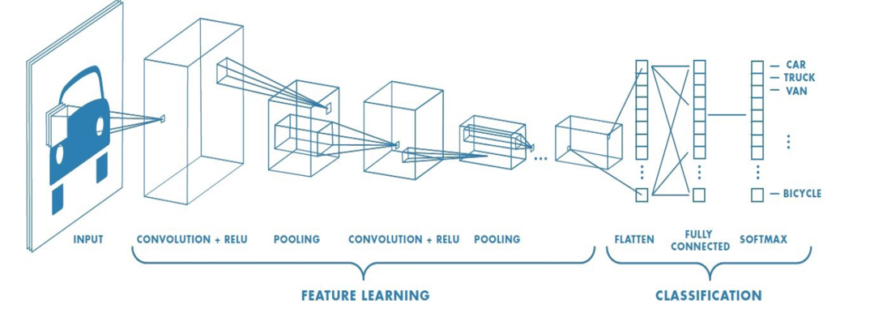
Application of Deep Learning Neural Network- Joint Detection
Image & Content Source: https://www.researchgate.net/figure/Infrared-image-from-the-anterior-view-of-the-knees-TRIATHLON_fig2_221924974

Slide 61
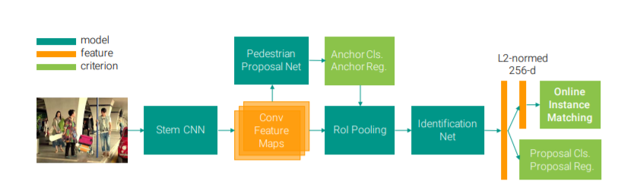
Application of Deep Learning Neural Network- Joint Detection
For Detection of Pedestrian
Image & Content Source: https://openaccess.thecvf.com/content_cvpr_2017/papers/Xiao_Joint_Detection_and_CVPR_2017_paper.pdf

Slide 62
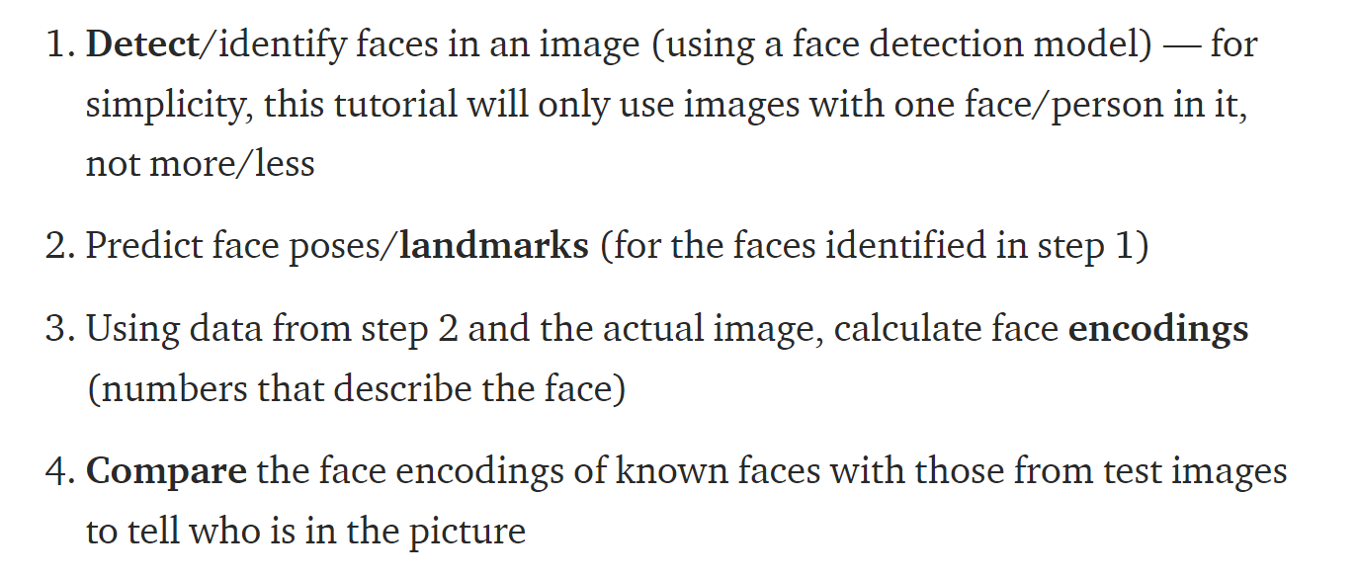
Application of Deep Learning Neural Network- Face Recognition
Image & Content Source: https://towardsdatascience.com/facial-recognition-using-deep-learning-a74e9059a150#

Slide 63
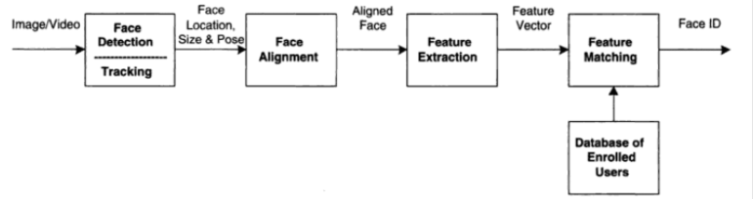
Application of Deep Learning Neural Network- Face Recognition
Image & Content Source: https://machinelearningmastery.com/introduction-to-deep-learning-for-face-recognition/

Slide 64

Dr. V. Vedanarayanan B.E., M.E., PhD
Assistant Professor, Department of ECE,
School of Electrical and Electronics
Sathyabama Institute of Science and technology
Vedanarayanan.etc@sathyabama.ac.in
This Photo by Unknown Author is licensed under CC BY

